Slide 1



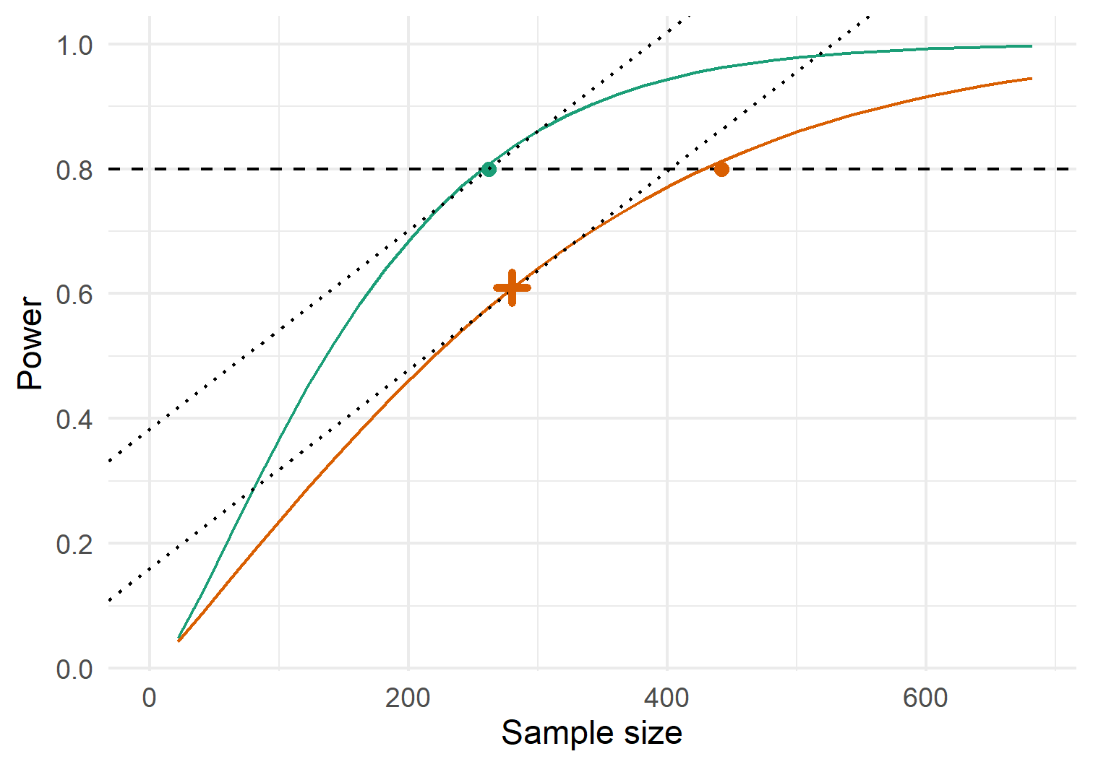
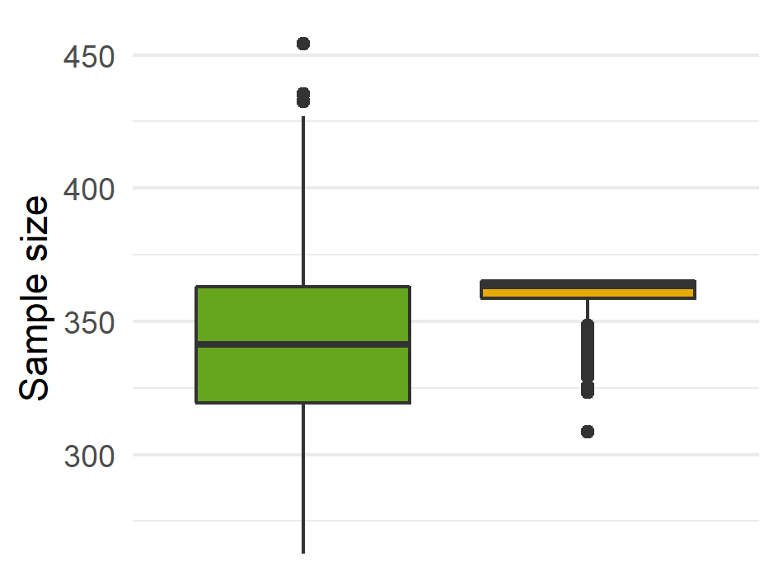
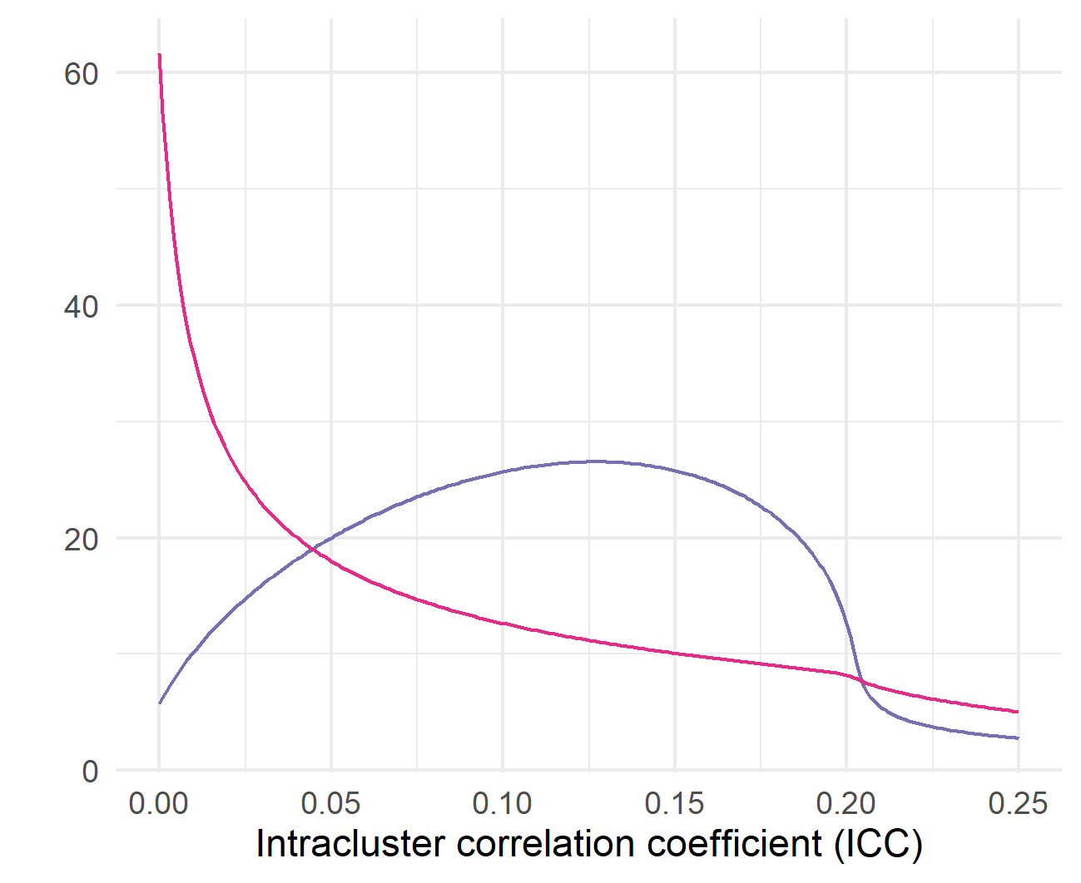
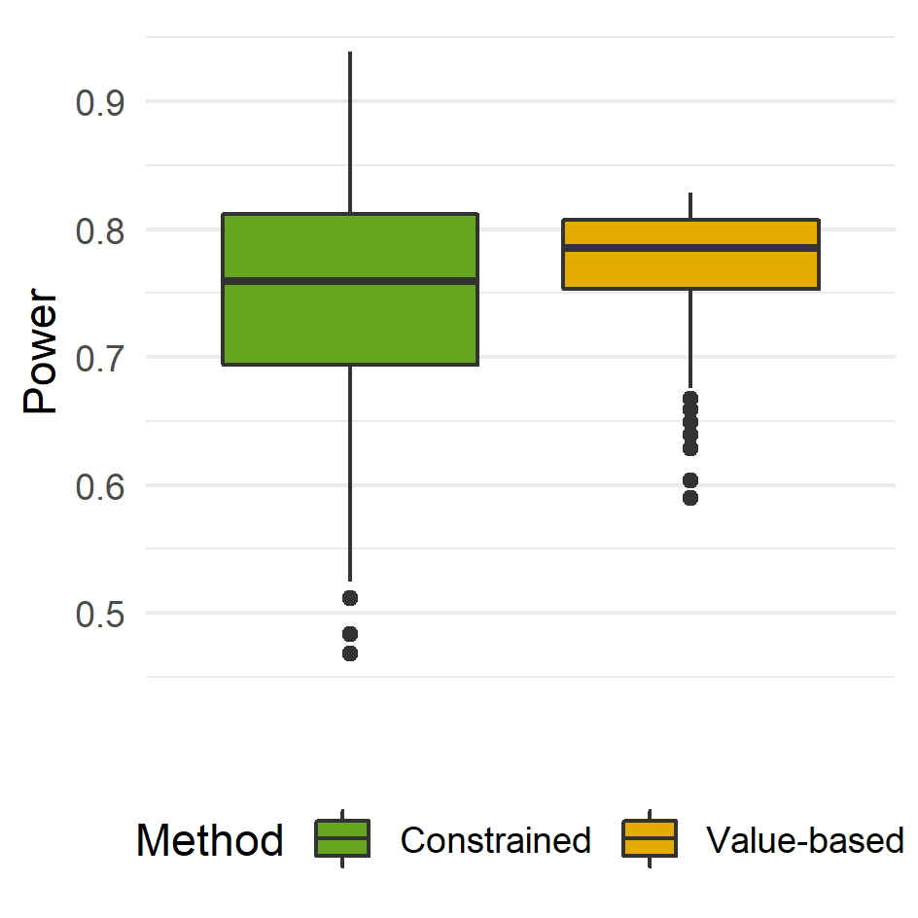
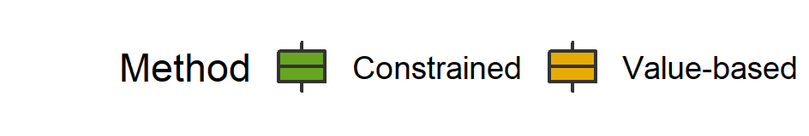
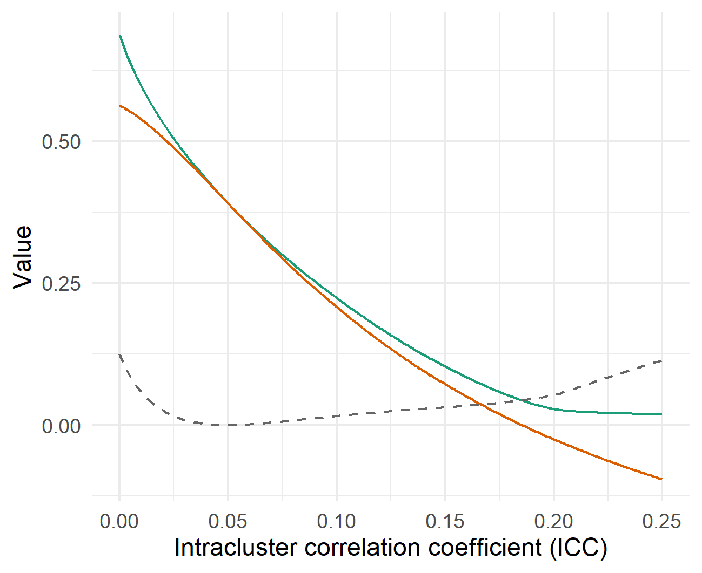

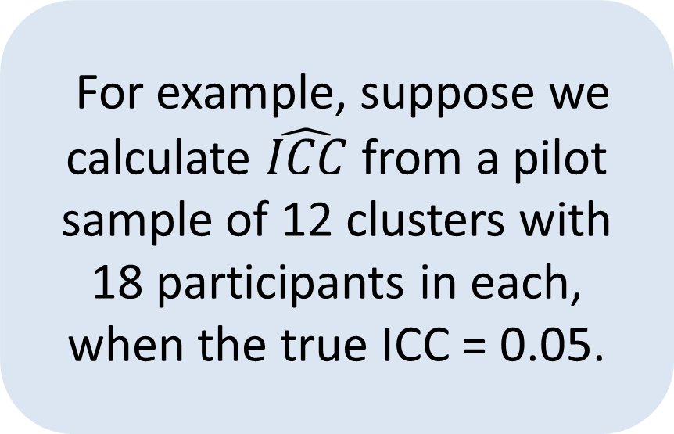
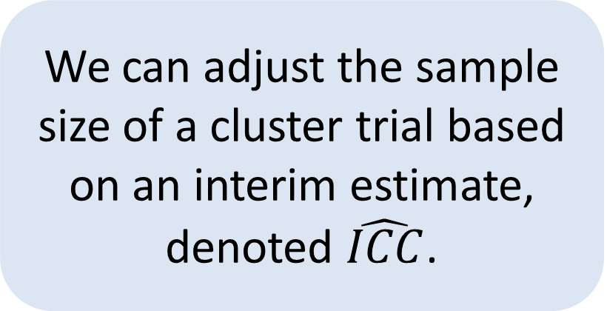
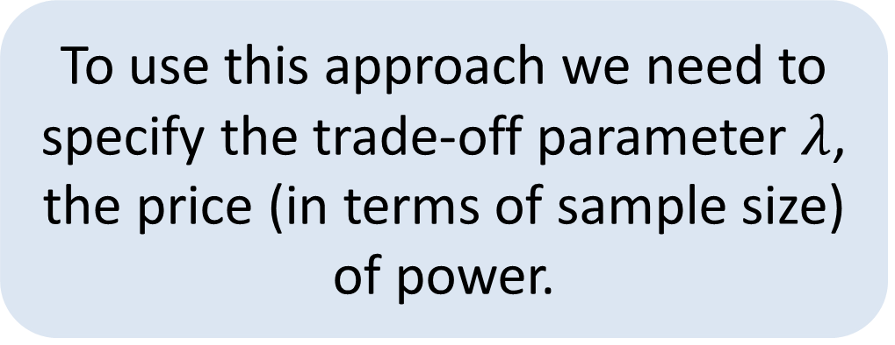
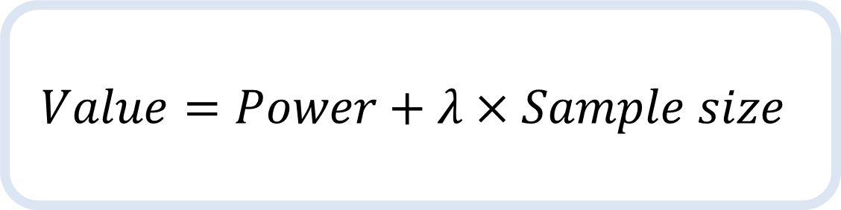
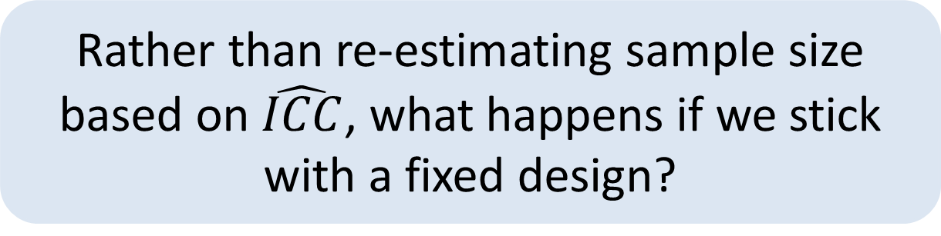
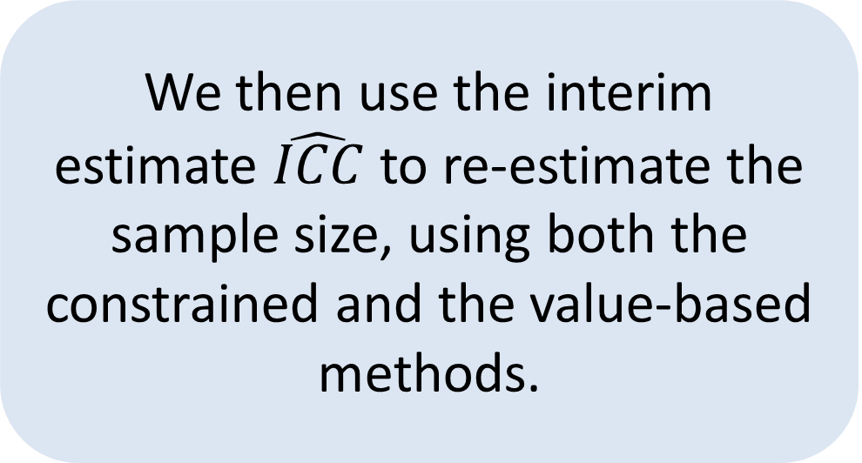
Robust, value-based sample size determination for cluster
randomised trials when nuisance parameters are unknown
Duncan T. Wilson
Leeds Institute of Clinical Trials Research, University of Leeds
@DTWilson, d.t.Wilson@leeds.ac.uk, https://github.com/DTWilson
Motivation
Proposal
The conventional constrained approach to sample sizing a cluster RCT: minimise sample size subject to some nominal power constraint, e.g. power > 0.8
Power when ICC = 0.02
An alternative value-based approach: choose the sample size which maximises value.
$$Value=Power+λ×Sample size$$
This method is sensitive to the (unknown) Intracluster Correlation Coefficient (ICC).
Optimal value-based designs
Now, an ICC of 0.07 requires a sample size of 280.
For example, an ICC = 0.02 requires a sample size of 262 for 80% power; an ICC of 0.07 requires 442.
Power when ICC = 0.07
To use this approach we need to specify the trade-off parameter $λ$, the price (in terms of sample size) of power.
Value-based sample size re-estimation
We find that the optimal number of clusters should initially increase with the ICC, before dropping down to 0.
We can adjust the sample size of a cluster trial based on an interim estimate, denoted $\hat{ICC}$.
For example, suppose we calculate $\hat{ICC}$ from a pilot sample of 12 clusters with 18 participants in each, when the true ICC = 0.05.
Optimal cluster size
We then use the interim estimate $\hat{ICC}$ to re-estimate the sample size, using both the constrained and the value-based methods.
Optimal number of clusters
We find that the value-based method leads to considerably less variability in the final sample size, and in the resulting power, compared with the constrained approach.
Robust fixed designs
Conclusions
Rather than re-estimating sample size based on $\hat{ICC}$, what happens if we stick with a fixed design?
Designing cluster RCTs based on value, a weighted sum of power and sample size, reduces sensitivity to the unknown ICC.
Value-based sample size re-estimation can lead to less variability in the final sample size.
When sample size re-estimation is not possible or desirable, we have shown that fixed designs can be quite robust to the unknown ICC.
Future work could generalise the method for other trial designs and nuisance parameters.
Value of optimal design
Here, we calculate the value of a cluster RCT with 20 clusters of 18 participants each.
Value of fixed design
We found that the fixed design’s value is not far from the optimal design’s value for a large range of true ICC values.
Difference in value
So, if we are confident the ICC is in this range then we can avoid re-estimation altogether.
More details, including all R code used to generate the results in this poster, can be found at https://github.com/DTWilson/Opt_pilot_ocs
This work was supported by the Medical Research Council [grant number MR/N015444/1].

